Slide 1

Hands-on Session 2: Electronic Health Records and Medical Text
RNN & Hands-on
ICU Mortality prediction
21.08.13 (13:00 ~ 15:00)
KAIST AI대학원 허경훈
Most slides from KAIST GSAI prof Choi Yoonjae Lectures

Slide 2
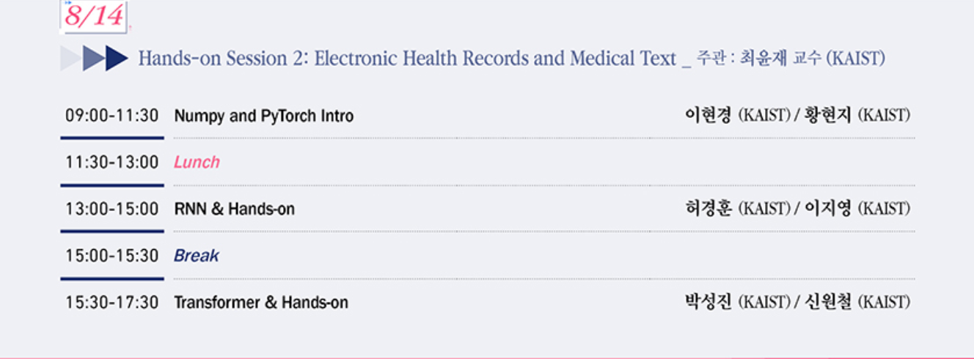
RNN & Hands-on

Slide 3
AGENDA
세션 소개
Electronic Health Recoreds (EHR)
Recurrent Neural Network (RNN)
Time Series EHR & RNN
핸즈온 세션 실습

Slide 4
AGENDA
세션 소개
Electronic Health Recoreds (EHR)
Recurrent Neural Network (RNN)
Time Series EHR & RNN
핸즈온 세션 실습

Slide 5
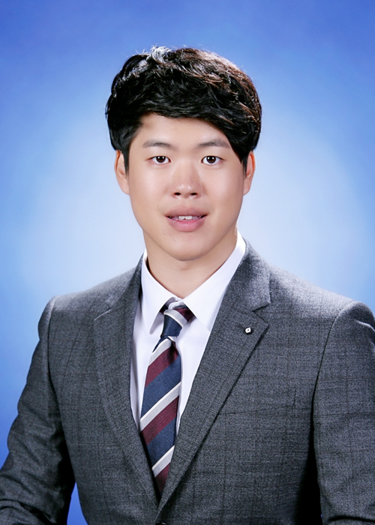
세션 소개
학력
학부 : 카이스트 생명화학공학과 졸업 (2013.03~2018.02)
석사 : 카이스트 생명화학공학과 졸업 Prof. Yoosik Kim (2018.03~2020.02)
-Thesis: MicroRNA trigger for self-modulating cellular therapy
박사 과정 중 : 카이스트 AI대학원 Prof. Edward Choi (2020.09~ )
-Research Interest: Machine learning for Healthcare, Electronic health record(EHR),
Medical domain AI, Bioinformatics
활동 및 대회
허경훈
Bronze medal (Top 7%): “Bengali.AI Handwritten Grapheme Classification” in Kaggle
-Classify the components of handwritten Bengali (Computer Vision) [2020.03]
• Silver medal (Top 3%): “Prostate Cancer Assessment (PANDA) challenge” in Kaggle
-Prostate cancer diagnosis using the Gleason grading system (Computer Vision) [2020.07])

Slide 6
세션 소개
Electronic Health Recoreds (EHR)
-> Public dataset
Recurrent Neural Network (RNN)
-> Model

Slide 7
세션 소개
Time Series EHR & RNN
-> Mortality prediction
핸즈온 세션 실습

Slide 8
AGENDA
세션 소개
Electronic Health Recoreds (EHR)
Recurrent Neural Network (RNN)
Time Series EHR & RNN
핸즈온 세션 실습

Slide 9

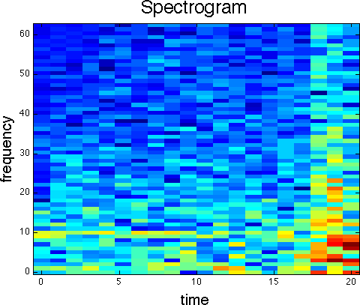
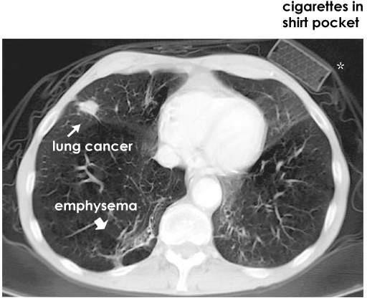
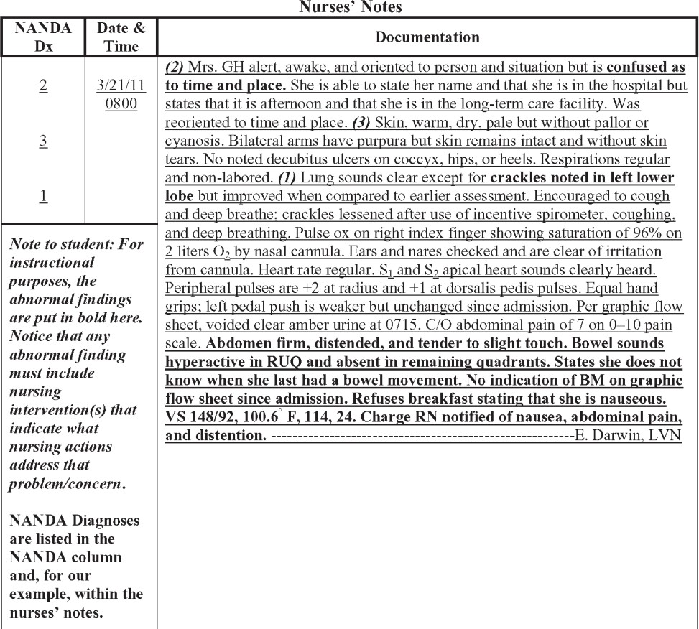
EHR
EHR consists of
Structured codes
Lab measures
Spectrograms (e.g. EEG)
Images (CT, MRI, X-ray)
Free text
Demographics
Billing Information
Genetic Information

Slide 10
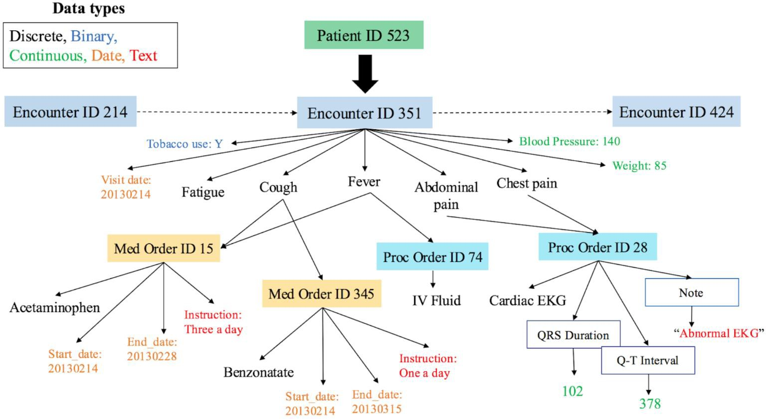
EHR - Structure of Electronic Health Records

Slide 11
EHR
Structured codes
Visit 1
Visit 2
Visit 3
Cough
Chill
Fever
Chest X-ray
Tylenol
Tylenol
Cough
Fever
IV fluid
EHR public datasets
MIMIC-III
Philips eICU
Korean National Insurance Claims

Slide 12
EHR – MIMIC-III
MIMIC –III (Medical Information Mart for Intensive Care)
Records from Intensive Care Unit (ICU)
Over 40,000 patients
Between 2001-2012
Contains
Vital signs
Lab test results
Medications
Caregiver notes
Imaging reports (not images themselves)
Mortality

Slide 13
EHR – MIMIC-III
Deidentification
EHR deidentification
Remove all names, location, very rare cases (over 90yo, rare disease, etc)
Shift dates
Ex: Date of birth 1964.06.12 → 2156.08.24
Preserve internal consistency (ex: admitted for 2 days in both raw data and deid data)
Preserve time of day, day of week, seasonality
Accessing MIMIC-III
https://mimic.physionet.org/gettingstarted/access/
Need to go through CITI training
https://www.citiprogram.org/index.cfm?pageID=154&icat=0&ac=0
Takes several hours, if done rigorously.

Slide 14
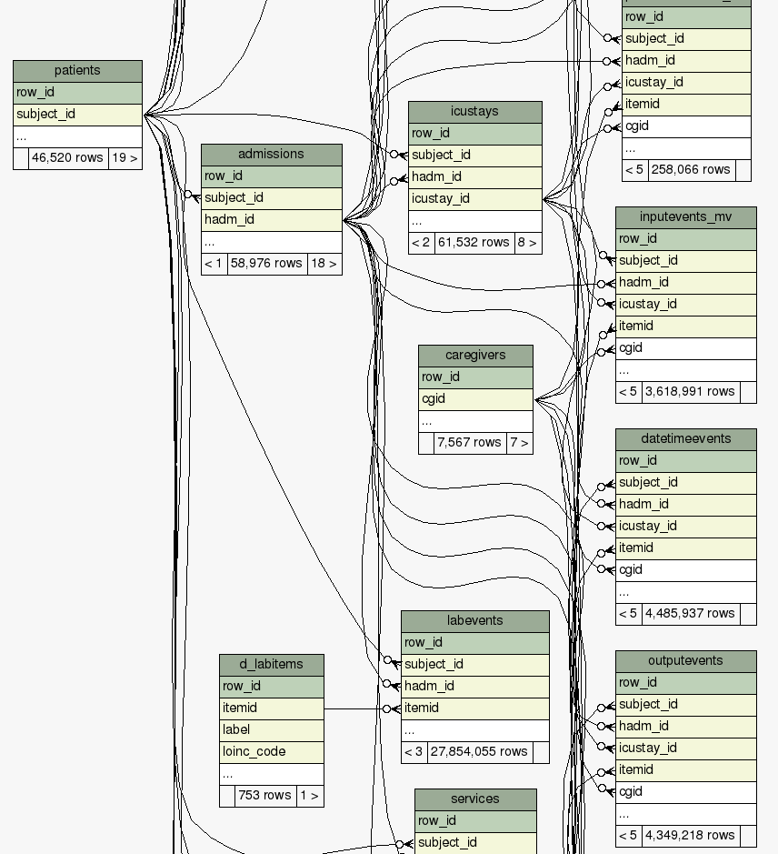
Tables of MIMIC-III
ADMISSIONS
CALLOUT
CPTEVENTS
DIAGNOSES_ICD
DRGCODES
ICUSTAYS
LABEVENTS
MICROBIOLOGYEVENTS
PATIENTS
PRESCRIPTIONS
PROCEDURES_ICD
SERVICES
TRANSFERS
CHARTEVENTS
DATETIMEEVENTS
INPUTEVENTS_CV
INPUTEVENTS_MV
NOTEEVENTS
OUTPUTEVENTS
PROCEDUREEVENTS_MV
…
…
https://mit-lcp.github.io/mimic-schema-spy/
Easy to identify primary keys, and links between tables

Slide 15
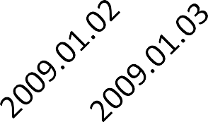
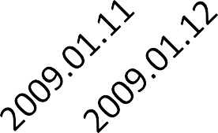
EHR – Addmision patterns
Hospital admission
ICU discharge
ICU admission
Hospital discharge
Patient 1

Slide 16



EHR – Addmision patterns
Hospital admission
2nd ICU discharge
1st ICU discharge
Hospital discharge
1st ICU admission
2nd ICU admission
Patient 2

Slide 17
EHR – Addmision patterns
1st Hospital admission
2nd Hospital admission
Patient 3
Hospital admission
Expired
ICU admission
Patient 4

Slide 18
EHR – Table soruces
Admission-related
ADMISSIONS CALLOUT CPTEVENTS DIAGNOSES_ICD
DRGCODES ICUSTAYS LABEVENTS
MICROBIOLOGYEVENTS
PATIENTS PRESCRIPTIONS PROCEDURES_ICD SERVICES TRANSFERS
Patient 1
Definitions
D_CPT D_ICD_DIAGNOSES D_ICD_PROCEDURES D_ITEMS D_LABITEMS
CHARTEVENTS DATETIMEEVENTS INPUTEVENTS_CV INPUTEVENTS_MV
NOTEEVENTS OUTPUTEVENTS PROCEDUREEVENTS_MV
ICU-related

Slide 19
AGENDA
세션 소개
Electronic Health Recoreds (EHR)
Recurrent Neural Network (RNN)
Time Series EHR & RNN
핸즈온 세션 실습

Slide 20
RNN
Bag-of-Words
Classical way to handle variable length sentences/documents
I gave the ball to John, who gave it to Mary
I:1, gave:2, the:1, ball:1, to:2, John:1, who:1, it:1, Mary:1

Slide 21
RNN - Bag-of-Words
I gave the ball to John, who gave it to Mary
I:1, gave:2, the:1, ball:1, to:2, John:1, who:1, it:1, Mary:1
All vocab Word count
a | 0
I | 0
ab | 0
… | …
… | …
ball | 2
… | …
gave | 2
… | …

Slide 22
RNN
Bag-of-Words
I gave the ball to John, who gave it to Mary
I:1, gave:2, the:1, ball:1, to:2, John:1, who:1, it:1, Mary:1
I gave the ball to Mary, who gave it to John
I:1, gave:2, the:1, ball:1, to:2, John:1, who:1, it:1, Mary:1
Different meaning, same representation!

Slide 23
RNN
. . .
X₀
X₁
X₂
X_{n-1}
X_{n}

Slide 24
RNN
. . .
X₀
X₁
X₂
X_{n-1}
X_{n}

Slide 25
RNN
Classification
y_{n}
. . .
X₀
X₁
X₂
X_{n-1}
X_{n}

Slide 26
RNN
Classification
y_{n}
. . .
h₀
h₁
h₂
h_{n-1}
h_{n}
. . .
X₁
X₂
X_{n-1}
X_{n}

Slide 27
RNN
Classification
based on states
y_{n}
Learned latent state and its dynamics
V
W
W
W
. . .
W
W
h₀
h₁
h₂
h_{n-1}
h_{n}
U
U
U
U
. . .
X₁
X₂
X_{n-1}
X_{n}

Slide 28
RNN
Classification
based on states
y_{n}
Learned latent state and its dynamics
V
W
W
W
. . .
W
W
h₀
h₁
h₂
h_{n-1}
h_{n}
U
U
U
U
. . .
X₁
X₂
X_{n-1}
X_{n}

Slide 29
RNN
Classification
based on states
Represent variable-length input
h_{t} = f(Wx_{t} + Uh_{t-1} + b)
f: non-linear activation function (originally tanh)
y_{n}
Learned latent state and its dynamics
V
W
W
W
. . .
W
W
h₀
h₁
h₂
h_{n-1}
h_{n}
U
U
U
U
. . .
X₁
X₂
X_{n-1}
X_{n}

Slide 30
RNN
Classification
Represent variable-length input
h_{t} = f(Wx_{t} + Uh_{t-1} + b)
f: non-linear activation function (originally tanh)
y_{n}
V
W
W
W
. . .
W
W
h₀
h₁
h₂
h_{n-1}
h_{n}
U
U
U
U
. . .
X₁
X₂
X_{n-1}
X_{n}

Slide 31
RNN
h_{t} = f(Wx_{t} + Uh_{t-1} + b)
Classification
Same weights at each timestep to handle variable-length sequence
U: h_{t-1} to h_{t}
W: x_{t} to h_{t}
y_{n}
V
W
W
W
. . .
W
W
h₀
h₁
h₂
h_{n-1}
h_{n}
U
U
U
U
. . .
X₁
X₂
X_{n-1}
X_{n}

Slide 32
RNN
h_{t} = f(Wx_{t} + Uh_{t-1} + b)
Classification
U: h_{t-1} to h_{t} W: x_{t} to h_{t}
y_{n}
Feedforward Neural Network with new information at each timestep.
But use the same weights repeatedly. h = f(Wx+ b)
V
W
W
W
. . .
W
W
h₀
h₁
h₂
h_{n-1}
h_{n}
U
U
U
U
. . .
X₁
X₂
X_{n-1}
X_{n}

Slide 33
RNN
h₀

Slide 34
RNN
W
h₀
h₁
U
X₁

Slide 35
RNN
y₁
V
W
h₀
h₁
U
X₁

Slide 36
RNN
y₁
V
W
W
h₀
h₁
h₂
U
U
X₁
X₂

Slide 37
RNN
y₁
y₂
V
V
W
W
h₀
h₁
h₂
U
U
X₁
X₂

Slide 38
RNN
y₁
y₂
V
V
W
W
W
. . .
h₀
h₁
h₂
U
U
. . .
X₁
X₂

Slide 39
RNN
y₁
y₂
V
V
W
W
W
. . .
W
h₀
h₁
h₂
h_{n-1}
U
U
U
. . .
X₁
X₂
X_{n-1}

Slide 40
RNN
y₁
y₂
Y_{n-1}
V
V
V
W
W
W
. . .
W
h₀
h₁
h₂
h_{n-1}
U
U
U
. . .
X₁
X₂
X_{n-1}

Slide 41
RNN
y₁
y₂
Y_{n-1}
V
V
V
W
W
W
. . .
W
W
h₀
h₁
h₂
h_{n-1}
h_{n}
U
U
U
U
. . .
X₁
X₂
X_{n-1}
X_{n}

Slide 42
RNN
y₁
y₂
Y_{n-1}
Y_{n}
V
V
V
V
W
W
W
. . .
W
W
h₀
h₁
h₂
h_{n-1}
h_{n}
U
U
U
U
. . .
X₁
X₂
X_{n-1}
X_{n}

Slide 43
RNN
y₁
y₂
Y_{n-1}
Y_{n}
V
V
V
V
W
W
W
. . .
W
W
h₀
h₁
h₂
h_{n-1}
h_{n}
U
U
U
U
. . .
X₁
X₂
X_{n-1}
X_{n}

Slide 44
RNN – Backpropagation
y₁
y₂
Y_{n-1}
Y_{n}
V
V
V
V
W
W
W
. . .
W
W
h₀
h₁
h₂
h_{n-1}
h_{n}
U
U
U
U
. . .
X₁
X₂
X_{n-1}
X_{n}

Slide 45
RNN – Backpropagation
y₁
y₂
Y_{n-1}
Y_{n}
V
V
V
V
W
W
W
. . .
W
W
h₀
h₁
h₂
h_{n-1}
h_{n}
U
U
U
U
. . .
X₁
X₂
X_{n-1}
X_{n}

Slide 46
RNN – Backpropagation
y₁
y₂
Y_{n-1}
Y_{n}
V
V
V
V
W
W
W
. . .
W
W
h₀
h₁
h₂
h_{n-1}
h_{n}
U
U
U
U
. . .
X₁
X₂
X_{n-1}
X_{n}

Slide 47
RNN
Y_{t}
X_{t}
t = 0
Time
The state (green) at any time is determined by the input at that time, and the state at the previous time
All columns are identical
An input at 𝑡𝑡 = 0 affects outputs forever
Also known as a recurrent neural net

Slide 48
RNN - Sequence prediction with RNN
Sentiment classification: Positive or Negative?
“This movie is as impressive as a preschool Christmas play”
1
2
3
4
5
6
7
8
9
10

Slide 49
RNN - Sequence prediction with RNN
Sentiment classification: Positive or Negative?
“This movie is as impressive as a preschool Christmas play”
Vocabulary
1
2
3
4
5
6
7
8
9
10
a | 1
I | 2
Christmas | 3
This | 4
… | …
impressive | 1000
… | …
preschool | 10000
… | …
Hidden Layer h₁
h₁= 𝝈(W_{i} x₁)
T
this
0, 0, 0, 1, 0, 0, 0, 0, 0, 0, 0, 0, …
x₁ (a vector with 1M elements. Only “this” is 1.)

Slide 50
RNN - Sequence prediction with RNN
Sentiment classification: Positive or Negative?
“This movie is as impressive as a preschool Christmas play”
1
2
3
4
5
6
7
8
9
10
Look up table embedding vector
Vocabulary
Hidden Layer h₁
a | 1
I | 2
Christmas | 3
This | 4
… | …
impressive | 1000
… | …
preschool | 10000
… | …
[1.38, -3.23, 0.6, 0.8, .. ]
[0.52, -3.23, 4.1, 0.59, .. ]
…
[0.35, -0.23, 0.37, 0.13, .. ]
…
…
…
…
…
h₁= 𝝈(W_{i} x₁)
T
this
[0.35, -0.23, 0.37, 0.13, .. ]
d

Slide 51
RNN - Sequence prediction with RNN
Sentiment classification: Positive or Negative?
“This movie is as impressive as a preschool Christmas play”
h₁
h₂
h₂= f(W_{h} h₁ + W_{i} x₂)
T T
This
movie
x₁
x₂

Slide 52
RNN
Sentiment classification: Positive or Negative?
“This movie is as impressive as a preschool Christmas play”
h₁
h₂
h₉
h10
h₁₀= 𝝈(W_{h} h₉ + W_{i} x₁₀)
T T
. . .
This
movie
Christmas
play

Slide 53
RNN
Sentiment classification: Positive or Negative?
“This movie is as impressive as a preschool Christmas play”
h₁
h₂
h₉
h10
h₁₀= 𝝈(W_{h} h₉ + W_{i} x₁₀)
T T
. . .
Output
y = 𝝈(w_{o}^{T}h₁₀) Outcome 0.0 ~ 1.0
This
movie
Christmas
play

Slide 54
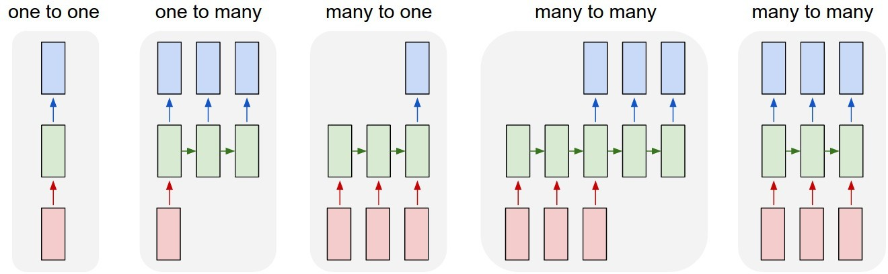
RNN
e.g. Image Captioning image → sequence of words
e.g. Sentiment Classification sequence of words → sentiment
e.g. Machine Translation
Seq. of words → seq. of words
e.g. Video classification on frame level

Slide 55
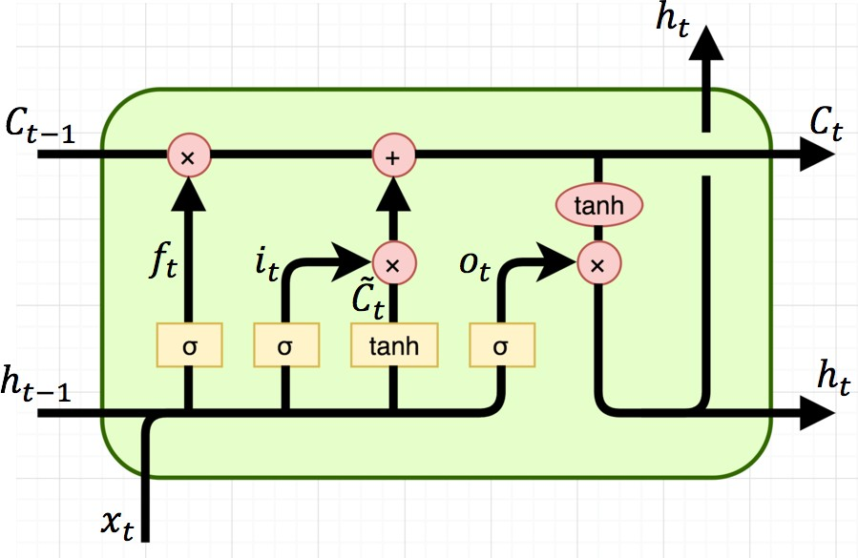
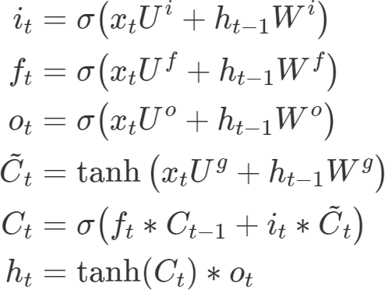
Long Short-Term memory (LSTM)
Consists of a memory cell and a set of gating units
Memory cell is the context that carries over
Forget gate controls erase operation
Input gate controls write operation
Output gate controls the read operation

Slide 56
Long Short-Term memory (LSTM)
Forget gate controls erase operation
Input gate controls write operation
Output gate controls the read operation
h_{t-1}
tanh
X_{t}

Slide 57

Long Short-Term memory (LSTM)
Forget gate controls erase operation
Input gate controls write operation
Output gate controls the read operation
c_{t-1}
h_{t-1}
tanh
X_{t}
c_{t}

Slide 58


Long Short-Term memory (LSTM)
Forget gate controls erase operation
Input gate controls write operation
Output gate controls the read operation
c_{t-1}
_{Ϭ}
h_{t-1}
tanh
X_{t}
c_{t}

Slide 59


Long Short-Term memory (LSTM)
Forget gate controls erase operation
Input gate controls write operation
Output gate controls the read operation
c_{t-1}
_{Ϭ}
h_{t-1}
tanh
X_{t}
_{Ϭ}
c_{t}

Slide 60
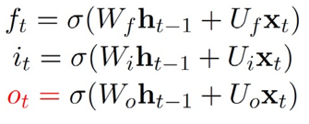
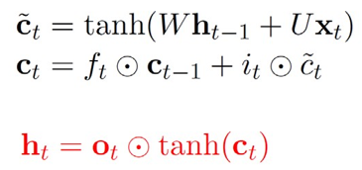
Long Short-Term memory (LSTM)
Forget gate controls erase operation
Input gate controls write operation
Output gate controls the read operation
c_{t-1}
_{Ϭ}
h_{t-1}
tanh
X_{t}
_{Ϭ}
tanh
c_{t}
_{Ϭ}

Slide 61
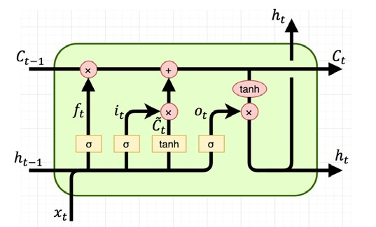
Long Short-Term memory (LSTM)
Forget gate controls erase operation
Input gate controls write operation
Output gate controls the read operation
c_{t-1}
_{Ϭ}
h_{t-1}
tanh
X_{t}
_{Ϭ}
tanh
c_{t}
_{Ϭ}

Slide 62
RNN
Application
Sequence-level classification/regression
Sentiment classification
Topic classification
Classification/regression at each step.
Language modeling
Part-of-speech tagging
Sequence-to-sequence
Translation
Question answering

Slide 63



Time Series EHR & RNN
Patient X
[Lab 4, Med2 ,Inf3, Lab2, Lab5, Inf1, Dx3, … ]
Time
[L1003, 7712 , 531, 9871, L2123, 1033, D454, … ]
Codes are recognized to just different code numbers

Slide 64
Time Series EHR & RNN
h₁
h₂
h₉
h10
Patient representation
. . .
Output
Blood
Pressure
measure
Drug A
Injection
Glucose Injection
Surgical
Process A

Slide 65
Time Series EHR & RNN
h₁
h₂
h₉
h10
Patient representation
. . .
Output
Vocabulary
Blood pressure | 1
Drug A inject | 2
Glucose inject | 3
Surgical process A | 4
… | …
… | …
… | …
Blood
Pressure
measure
Drug A
Injection
Glucose Injection
Surgical
Process A

Slide 66
Time Series EHR & RNN
h₁
h₂
h₉
h10
Patient representation
. . .
Output
Vocabulary
Blood pressure | [1.38, -3.23, 0.6, .. ]
Drug A inject | [0.52, -3.23, 4.1, .. ]
Glucose inject | …
Surgical process A | [0.35, -0.23, 0.37, .. ]
… | …
… | …
… | …
Blood
Pressure
measure
Drug A
Injection
Glucose Injection
Surgical
Process A
[1.38, -3.23, 0.6, .. ]

Slide 67
Time Series EHR & RNN
h₁
h₂
h₉
h10
Patient representation
. . .
Output
Blood
Pressure
measure
Drug A
Injection
Glucose Injection
Surgical
Process A
Readmission
Mortality
Length of stay
Diagnosis

Slide 68
Time Series EHR & RNN
h₁
h₂
h₉
h10
Patient representation
. . .
Output
Blood
Pressure
measure
Drug A
Injection
Glucose Injection
Surgical
Process A
Expired
Readmission
ICU admission
Hospital admission
Mortality
input
Length of stay
Diagnosis
Patient 4

Slide 69
핸즈온 세션 실습
실습 목표 : 시계열 환자 데이터(MIMIC-III의 Chartevent) 를 가지고 사망 예측
세부 설명 : 입원 기간이 24시간에서 48시간 사이인 ICU 기록이 주어지면
(즉, 1일 <= 입원 기간 <= 2일)
처음 3시간의 정보를 사용하여 환자가 24시간에서 48시간 동안 사망할 것인지 예측
환자의 입원 시간이 24시간 미만 또는 48시간 초과인 경우는 모두 제외해야함.
데이터셋 : 각 환자에는 하나 이상의 ICU 입원 기록이 있으며,
각 ICU 입원에는 ICUSTAY_ID로 표시된 고유 ID가 있습니다
CHARTEVENTS.csv ADMISSION.csv ICUSTAY.CSV
조건 : 시계열 이벤트의 최대 길이는 100 으로 제한

Slide 70
핸즈온 세션 실습
1
Raw 데이터셋 다운로드
MIMIC-III Demo dataset
2
전처리
Pandas DataFrame 으로 전처리
3
학습 및 테스트 데이터셋 구성
학습 데이터셋과 테스트 데이터셋을 Numpy로 구성
4
RNN 모델 구성 및 학습
Pytorch 라이브러리를 사용하여 RNN 학습 파이프라인 구성
(Demo가 아닌 실제 MIMIC-III 데이터로 학습)
5
학습된 모델로 테스트 셋에 예측
학습된 모델에 테스트셋 Inference

Slide 71
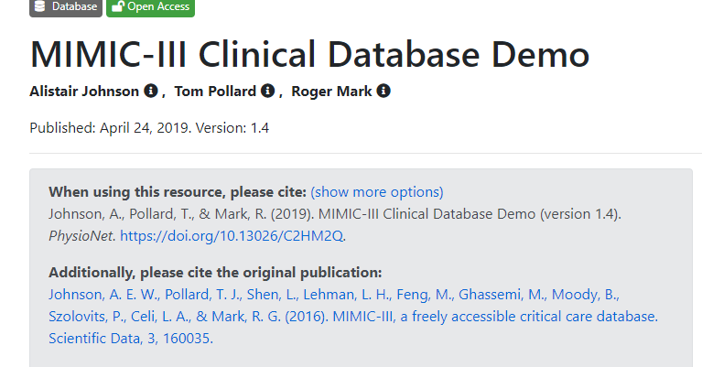
핸즈온 세션 실습
https://physionet.org/content/mimiciii-demo/1.4/

Slide 72
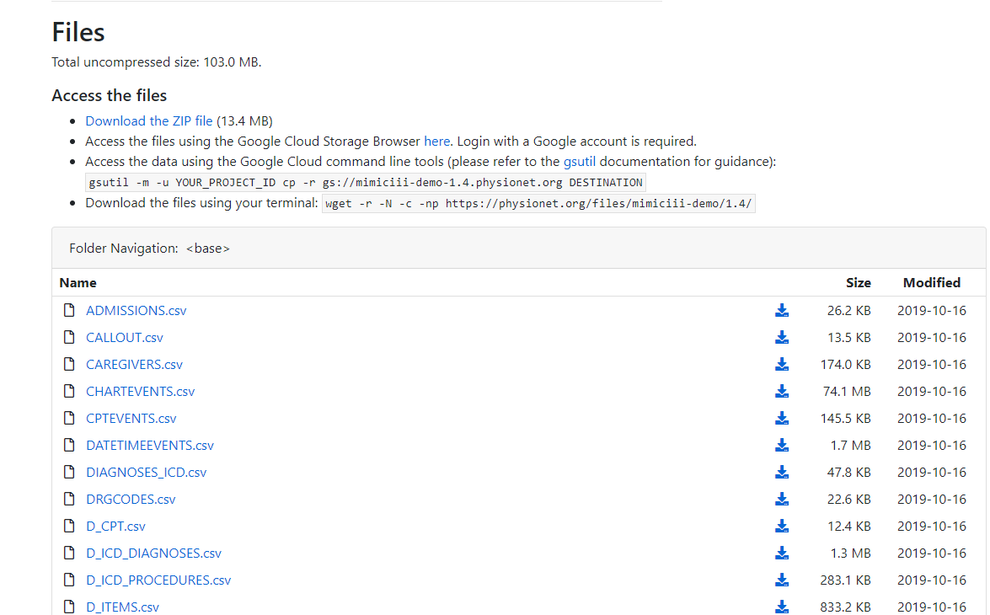
핸즈온 세션 실습
https://physionet.org/content/mimiciii-demo/1.4/
CHARTEVENTS.csv
ADMISSION.csv
ICUSTAY.CSV
데모 데이터셋으로 전처리 연습
실제 MIMIC-II 로 학습

Slide 73
핸즈온 세션 실습
Google Colab
https://colab.research.google.com/drive/1fWH8fhN2kuvI6a_mMFqGnpKrU3FijVDa?usp=sharing

